Slide 2
Intro to Ansible for Automation
Alexander Stevenson, Developer Advocate @alexstev_dev
DEVWKS-1700

Slide 3

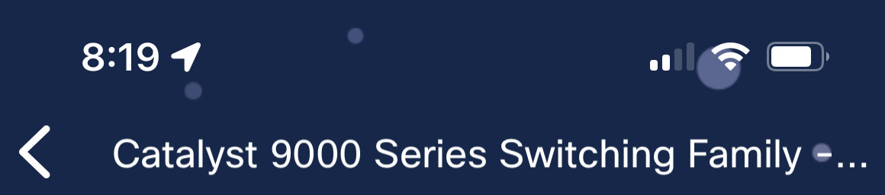
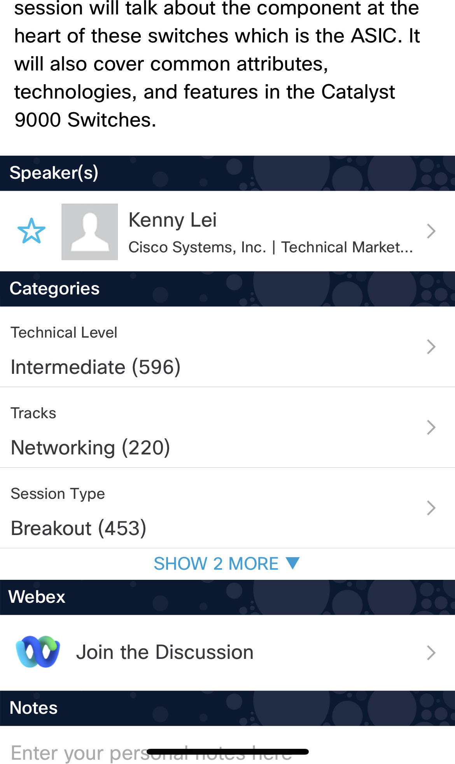

Cisco Webex App
https://ciscolive.ciscoevents.com/ ciscolivebot/#BRKXXX-xxxx
Questions? Use Cisco Webex App to chat with the speaker after the session
How
1
Find this session in the Cisco Live Mobile App
Click “Join the Discussion”
Install the Webex App or go directly to the Webex space
Enter messages/questions in the Webex space
2
3
4
Webex spaces will be moderated by the speaker until June 7, 2024.
Enter your personal notes here
© 2024 Cisco and/or its affiliates. All rights reserved. Cisco Public

Slide 4
Introduction

Slide 5
Speaker
Alexander Stevenson
Developer Advocate and DevNet Engineer at Cisco DevNet
A Cisco Code Exchange, Cisco Blogs, and Cisco Community published author
Co-creator and lead content developer of the ‘DevOps Shop’ video series
Certifications: DevNet Specialist – DevOps, DevNet Associate, and Cisco Certified Cyber Ops Associate

Slide 6

Speaker
(continued)
Alexander Stevenson
Four years at Cisco, previously a software engineer at Apple
Earned M.Ed, B.Sc. in Network Systems, and Diploma in Full-Stack Software Engineering
Proud cat custodian

Slide 7

“Ansible enables you to simplify complex tasks, increase efficiency, and ensure consistency in your IT environment.”
Red Hat

Slide 8
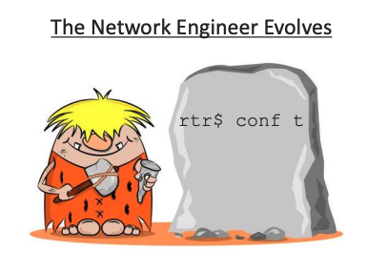
“We just copy/paste CLI commands and it’s been working for us for years. What’s the worst that can happen?”
Network Engineer from the Dark Ages

Slide 9

The "London Whale" trading scandal was a case of a complex and risky trading strategy that went wrong due to a mistake in the spreadsheet model used by the traders. The error involved copying and pasting values from one file to another without checking if they were correct or consistent.
$6 billion loss for JPMorgan Chase!

Slide 10


Slide 11


Slide 12
Getting Started
The Ansible Playbook
Installing Ansible
The Ansible Config File
Demos:
Our First Playbook
Git with the Program
cURLs with Ansible Fun

Slide 13
Learn More:
DevNet Learning Labs
DevNet Sandboxes
Ansible-Projects
Cisco Code Exchange
DevOps Shop: Intro to Ansible for Automation
Summary and Looking forward
Addendum: Ansible-Navigator

Slide 14
Getting Started

Slide 15
Ansible
Popular suite of software tools which enables infrastructure-as-code (IaC)
Open-source
Functionality
Provisioning
Configuration management
Deployment
Configure both Unix-like systems and MS Windows
The Ansible control node runs on most Unix-like and Windows systems that are able to run Python
Agentless – temporary, remote connections
Ansible does not need to be installed on end devices

Slide 16
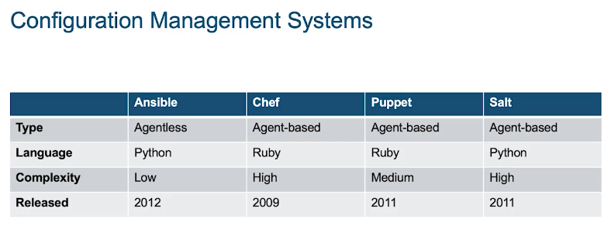
Ansible

Slide 17

Ansible playbook
A playbook is the main means of Ansible automation. Each playbook is a collection of tasks and each task contains modules. Playbooks are written in YAML, which is intuitive and human readable. Space indentation is important.
---
- name: Define Paramenters
hosts: iosxe_devices
connection: network_cli
tasks:
- name: load new acl into device
ios_config:
lines:
- 10 permit ip host 10.10.20.49 any log
- 20 permit ip host 10.10.20.50 any log
- 30 permit ip host 10.10.20.51 any log
parents: ip access-list extended my_acl
before: no ip access-list extended my_acl
match: exact
YAML
devices
method
module
configuration
configuration hierarchy
run before

Slide 18

First Steps
Change directory into the folder for our workshop
cd /home/devnet/workshop/DEVWKS-1700
Ansible installation
Check: ansible-config --version
Install (if necessary): pip install --user ansible
Re-check (if necessary): ansible-config --version
Ansible config file
What is it?
Where to store/find it
How to create it with the CLI

Slide 19
Set-up Commands
Verify Ansible installation
ansible-config --version
If Ansible is not installed
pip install --upgrade ansible
ansible-config --version
cat commands.txt

Slide 20
The Ansible Config file (ansible.cfg)
Config file
Allows users to see all the configuration settings available, their defaults, how to set them and where their current value comes from
For a new install, the results may be config file = None

Slide 21
Config file example
A very basic config file can look something like this, but can include much more, such as SSH keys, remote users, and roles.
[defaults]
gathering = explicit
host_key_checking = True
timeout = 30
deprecation_warnings = False
retry_files_enabled = False
DEFAULT_LOCAL_TMP = ./ansible_tmp
transport = paramiko
look_for_keys = False

Slide 22
Config file example
(Continued / Explained)
[defaults]
gathering = explicit ← only gather facts for hosts that are explicitly targeted by the playbook
host_key_checking = True ← enables the SSH key checking feature
timeout = 30 ← sets the connection timeout in seconds for connections to remote hosts
deprecation_warnings = False ← disables deprecation warning
retry_files_enabled = False ← disables creation of a .retry file with the hosts that failed
DEFAULT_LOCAL_TMP = ./ansible_tmp ← sets the default local temporary directory
transport = paramiko ← sets default transport method to use when connecting to remote hosts
look_for_keys = False ← when connecting to remote hosts, don’t search for private keys in ~/.ssh/

Slide 23
Config file – Where to store/find it
Ansible looks for the ansible.cfg configuration file in the following order:
ANSIBLE_CONFIG (environment variable if set)
ansible.cfg (in the current directory)
~/.ansible.cfg (in the home directory)
/etc/ansible/ansible.cfg (default system-wide configuration file)
Ansible uses the first ansible.cfg file it finds and will not load any other configuration file afterwards. So, if you have an ansible.cfg in your current directory, Ansible will use that and ignore the one in your home directory or the default one in /etc/ansible/ansible.cfg.

Slide 24
Config file – Let’s create one!
We create ansible.cfg in the current dir and then verify its contents
echo -e "[defaults]\ngathering = explicit\nhost_key_checking = True\ntimeout = 30\ndeprecation_warnings = False\nretry_files_enabled = False\nDEFAULT_LOCAL_TMP = ./ansible_tmp\ntransport = paramiko\nlook_for_keys = False" > ansible.cfg
cat ansible.cfg

Slide 25
Demos

Slide 26

Our First Playbook

Slide 27
Let’s Use Automation Instead of Copy/Paste !
Everything you just did by copying and pasting, which is still common among some network engineers, we will demonstrate can be accomplished with a single command to run a playbook using Ansible.
cd ansible-playbooks
ansible-playbook first_playbook.yaml

Slide 28
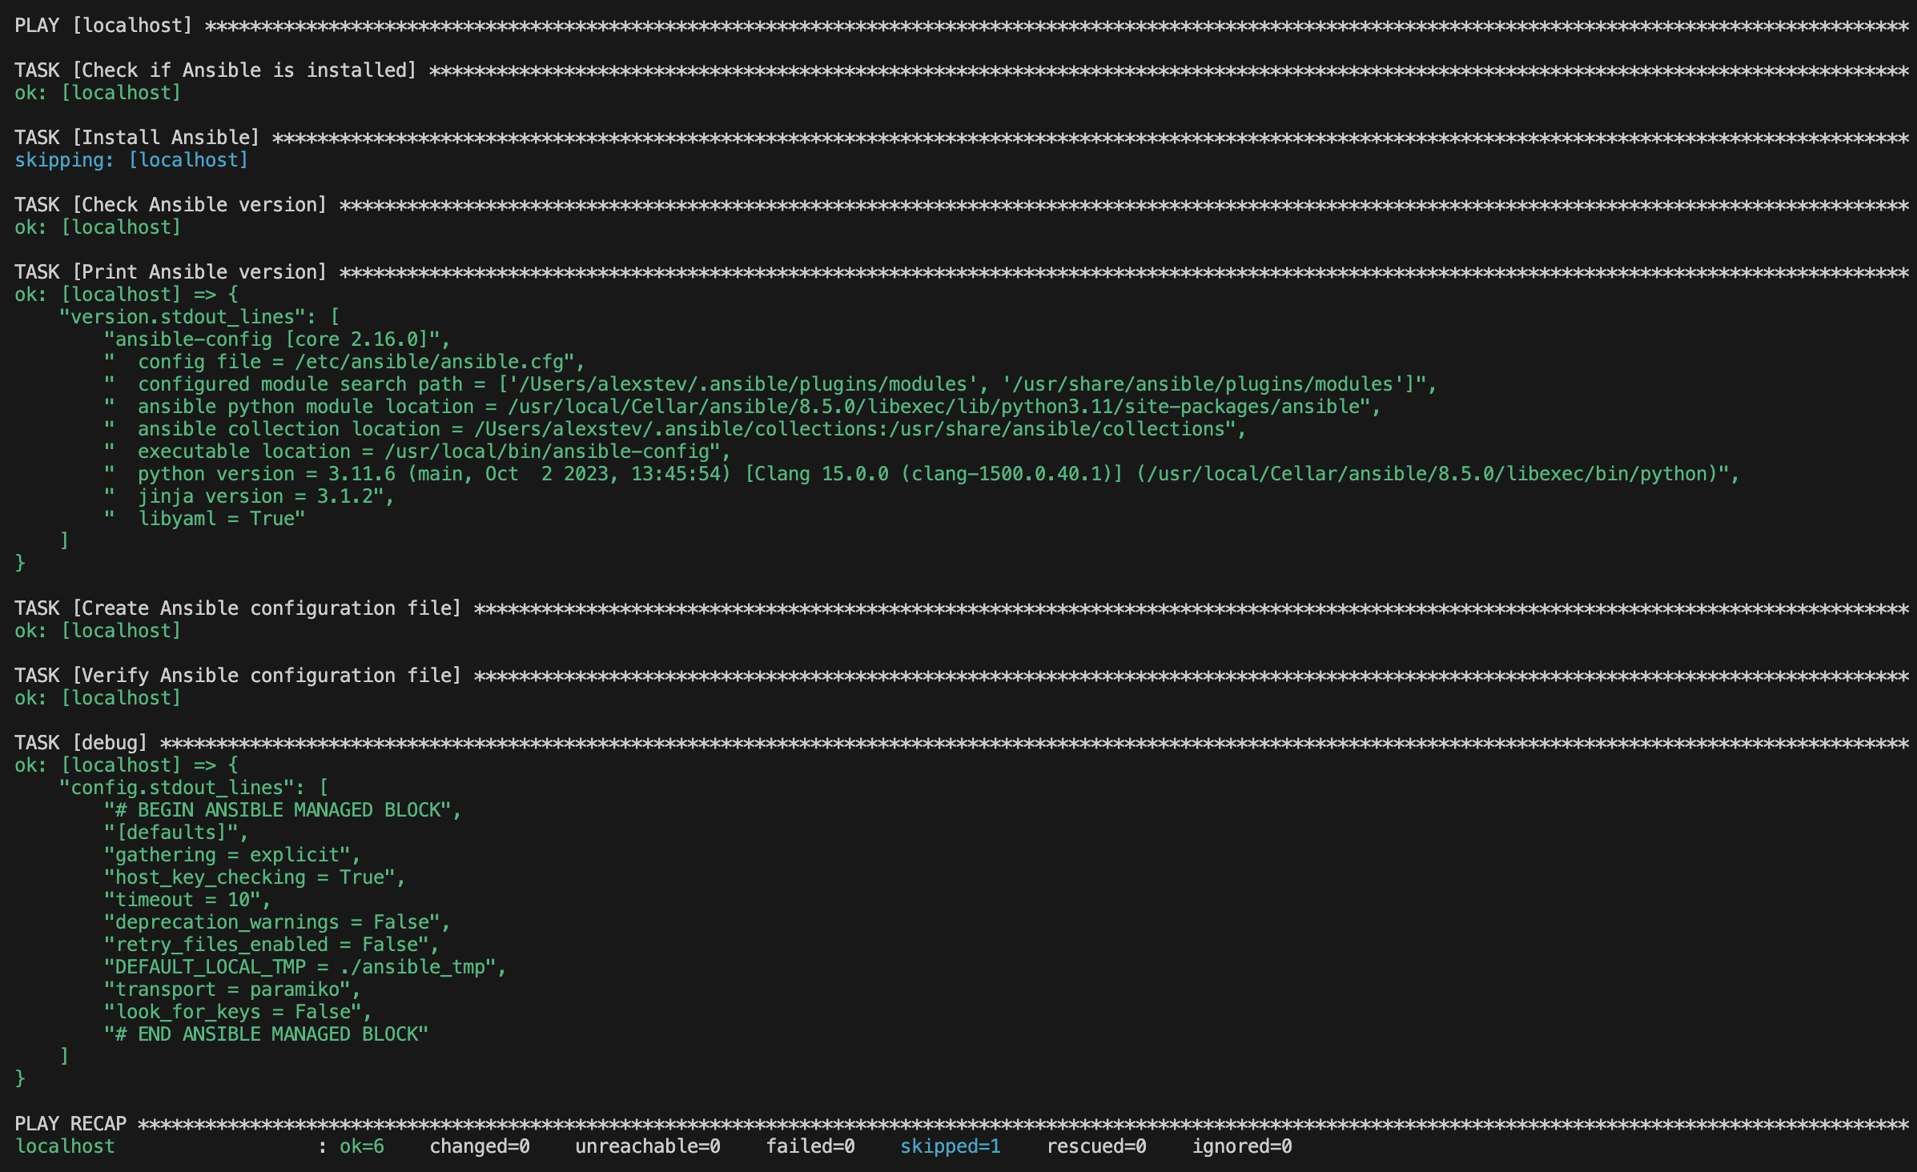
Results

Slide 29
Ansible playbook
A playbook is the main means of Ansible automation. Each playbook is a collection of tasks and each task contains modules. Playbooks are written in YAML, which is intuitive and human readable. Space indentation is important.
---
- name: Define Paramenters
hosts: iosxe_devices
connection: network_cli
tasks:
- name: load new acl into device
ios_config:
lines:
- 10 permit ip host 10.10.20.49 any log
- 20 permit ip host 10.10.20.50 any log
- 30 permit ip host 10.10.20.51 any log
parents: ip access-list extended my_acl
before: no ip access-list extended my_acl
match: exact
YAML
devices
method
module
configuration
configuration hierarchy
run before

Slide 30
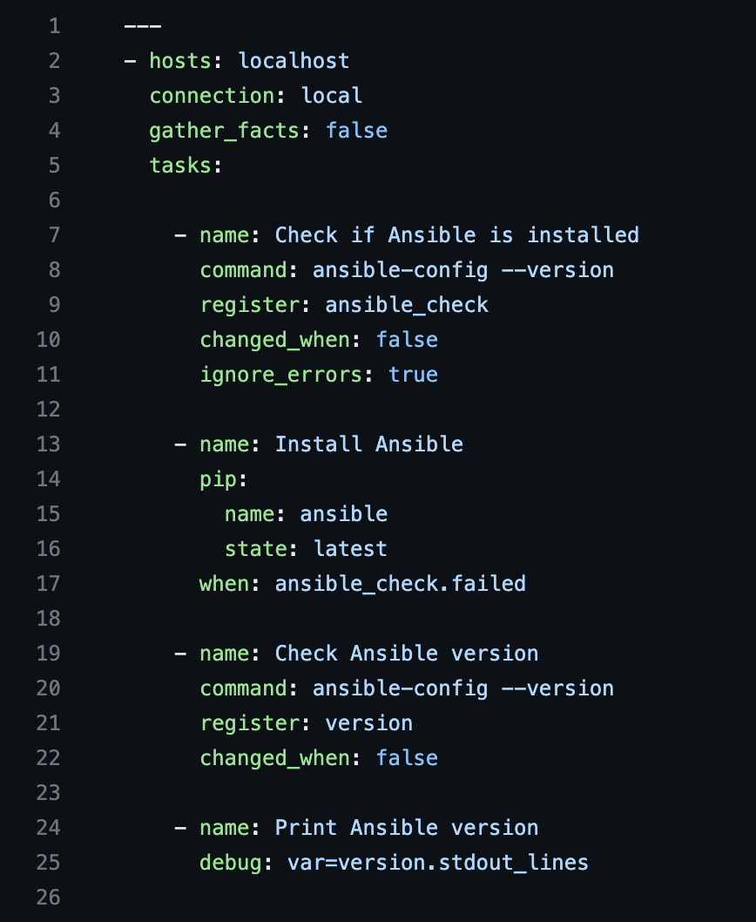
first_playbook.yaml

Slide 31
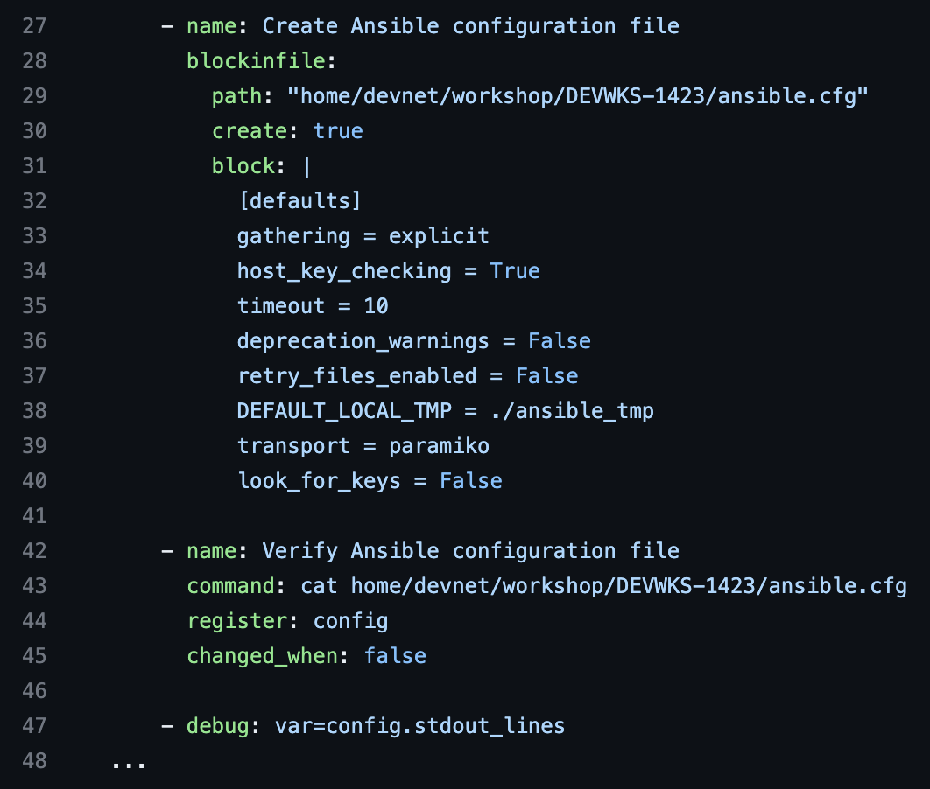
first_playbook.yaml
(continued)

Slide 32

Git with the Program

Slide 33
We will have Ansible pull a playbook from a GitHub repo and then run that playbook.
We have a playbook called github.yaml that we will run to download a playbook called hello_world.yaml from a GitHub repo and then run that playbook, which will print a Hello World message.
ansible-playbook github.yaml

Slide 34
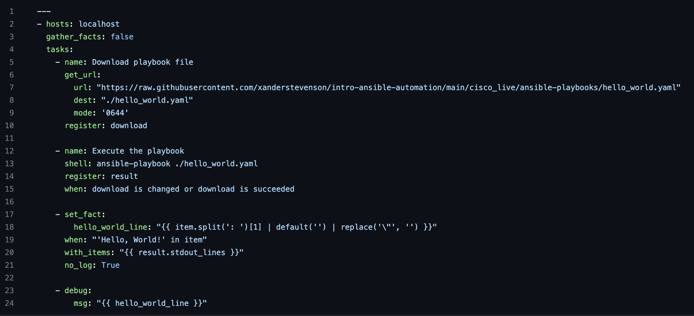
ansible_playbooks/github.yaml

Slide 35
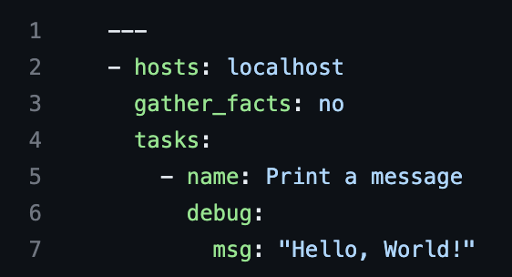
https://github.com/xanderstevenson/intro-ansible-automation/blob/main/cisco_live/ansible-playbooks/hello_world.yaml

Slide 36
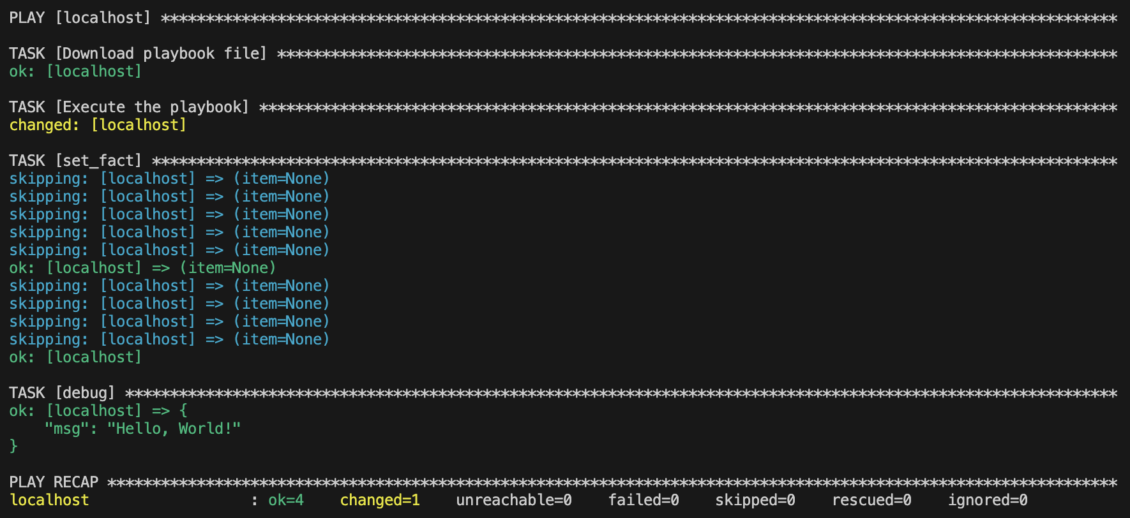
Output

Slide 37

cURLs with Ansible Fun

Slide 38
ansible_playbooks/curl.yaml
---
- hosts: ___________
connection: ___________
gather_facts: ___________
tasks:
- name: Check if jq is installed
shell: ___________
register: jq_installed
failed_when: false
changed_when: false
- name: Download and install jq
get_url:
url: https://github.com/stedolan/jq/releases/download/jq-1.6/jq-linux64
dest: "home/devnet/workshop/DEVWKS-1700/jq"
mode: '0755'
when: jq_installed.rc != 0
command -v jq
localhost
local
false

Slide 39
ansible-playbook curl.yaml
(answers)
---
- hosts: localhost
connection: local
gather_facts: false
tasks:
- name: Check if jq is installed
shell: command -v jq
register: jq_installed
failed_when: false
changed_when: false
- name: Download and install jq
get_url:
url: https://github.com/stedolan/jq/releases/download/jq-1.6/jq-linux64
dest: "home/devnet/workshop/DEVWKS-1700/jq"
mode: '0755'
when: jq_installed.rc != 0

Slide 40
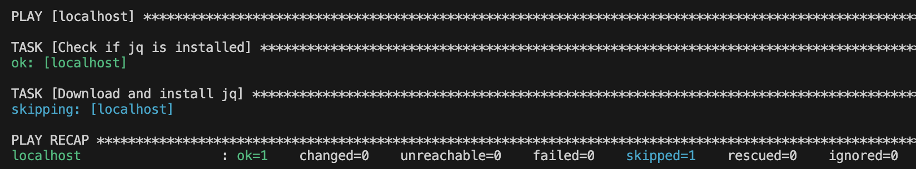
Idempotency
Because jq is already installed, we have ok=1 and changed=0. No matter how many times we re-run this playbook, it will never try to re-install jq if it’s already installed. If Ansible would have installed it, changed would equal 1.

Slide 41

Something is VVVery Wrong

Slide 42
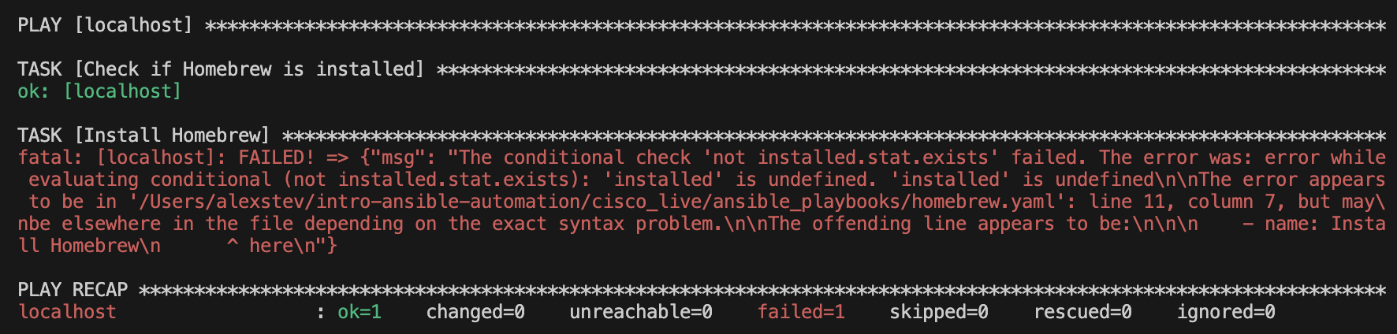
What does it look like when a playbook fails and how do we troubleshoot?
ansible-playbook

Slide 43
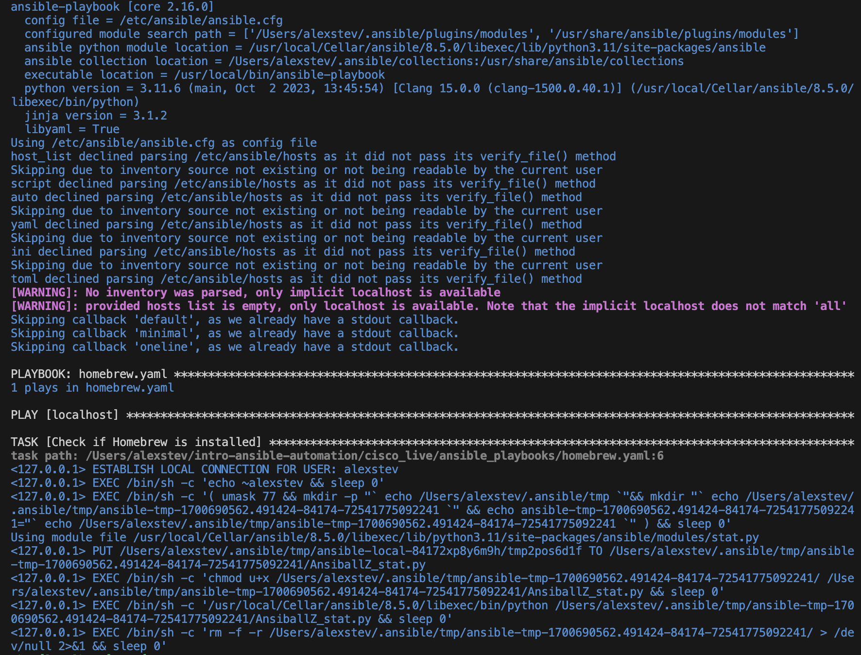
The verbose flag
ansible-playbook -vvv
-v for low verbosity
-vv for medium verbosity
-vvv for high verbosity
-vvvv for connection debugging verbosity

Slide 44
DevNet Learning Labs

Slide 45
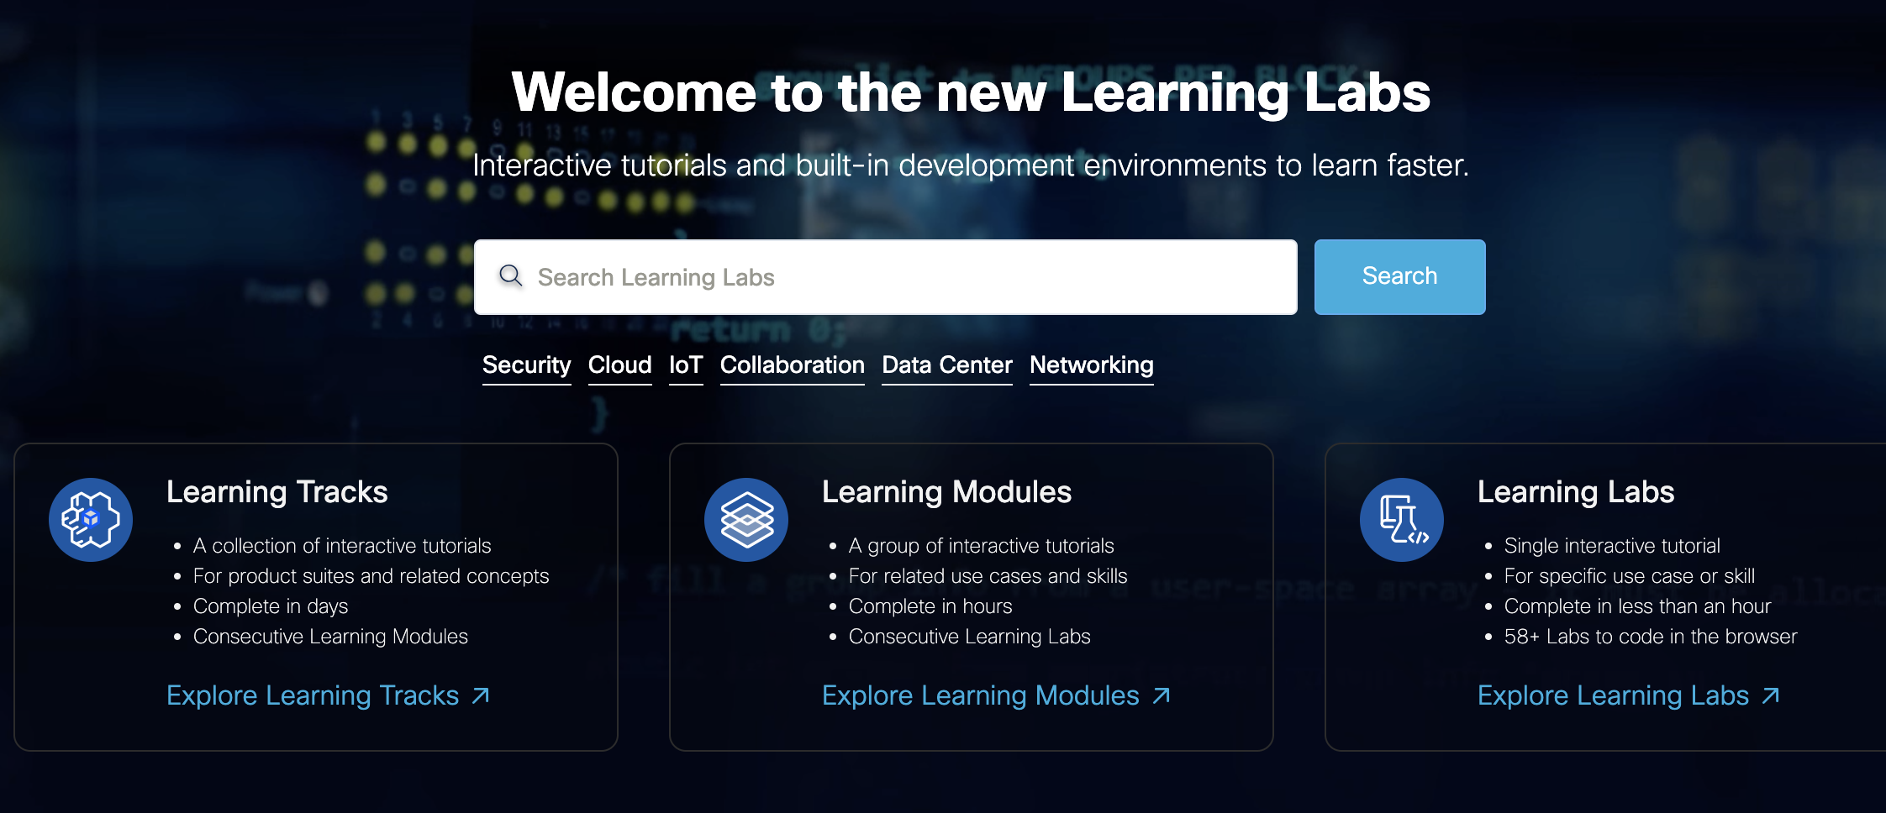
The new Learning Labs Center at https://developer.cisco.com/learning has an abundance of FREE Ansible offerings.

Slide 46
Free Ansible Learning Labs at Cisco DevNet
Learning Tracks: 26
…consist of
Learning Module: 109
…consist of
Learning Labs: 334
developer.cisco.com/learning

Slide 47
At the present time, just searching for “Ansible” we can find learning modules such as these:
Introduction to Ansible
Ansible Exploration
Introduction to ACI and Ansible
Cisco Secure Workload (Tetration) and Ansible
Using Ansible with Cisco DNAC
Introduction to Ansible for IOS XE Configuration Management
And more….

Slide 48
DevNet Sandboxes

Slide 49
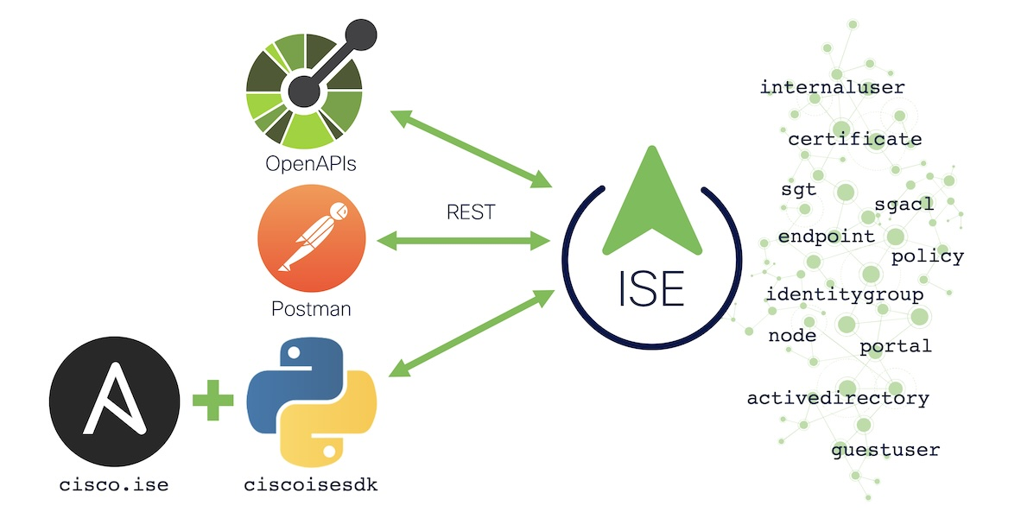
Some of the learning labs we have mentioned make use of the FREE DevNet sandboxes at https://devnetsandbox.cisco.com/
There is currently a reservable sandbox called ‘Identity Services Engine 3.2’, where you can learn how to make operational updates to ISE with Ansible. The APIs are used by our new Ansible modules to automate the provisioning of an ISE deployment:
https://devnetsandbox.cisco.com/DevNet/catalog/ise-sandbox

Slide 50
Ansible-Projects

Slide 51
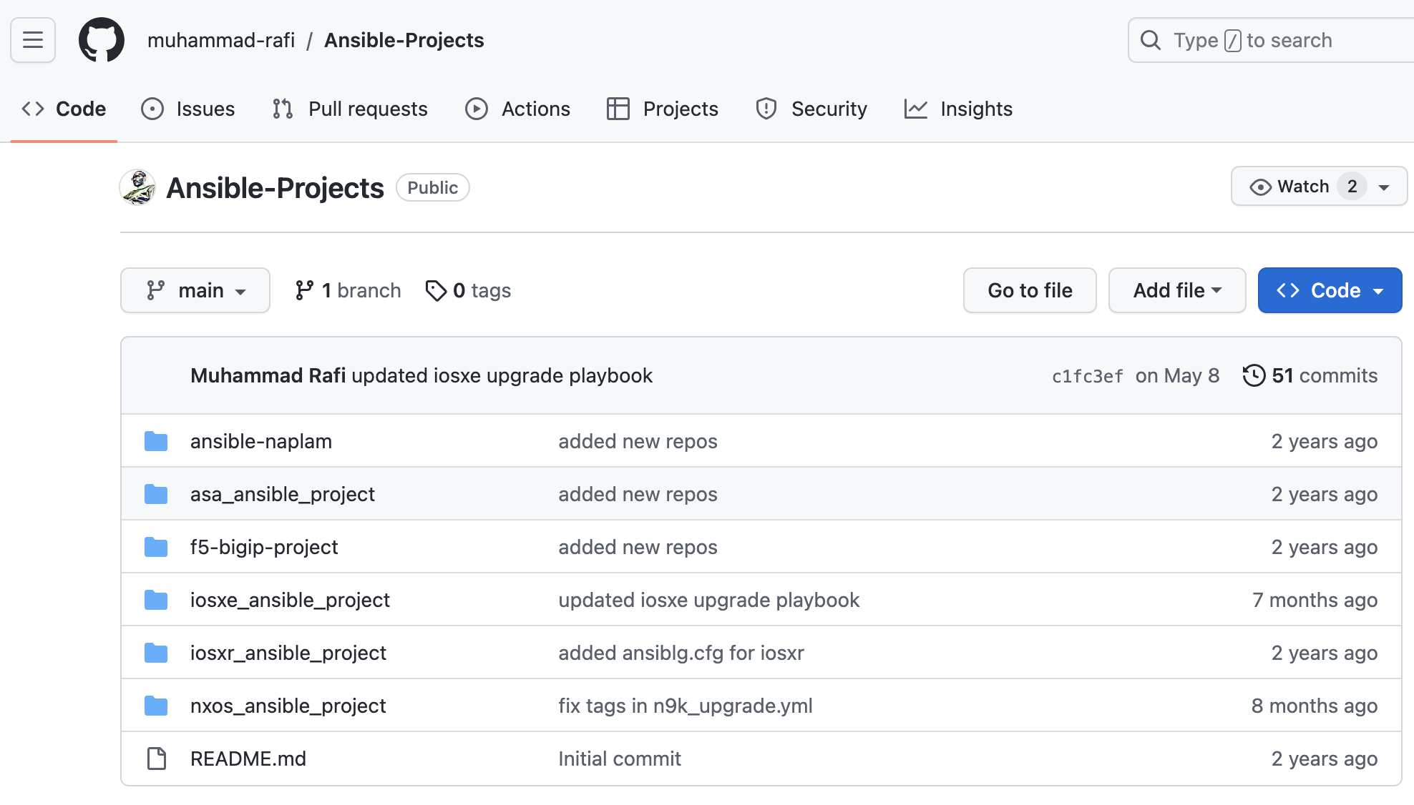
Most of the demos we’ve seen in this video involve the devices in the free DevNet Always On Sandboxes. For an extensive list of working Ansible files from IOS XE, as well as IOS XR, NX-OS, and ASA projects, including playbooks, variables, configs and scripts, check out the Ansible-Projects repo from Muhammad Rafi:
https://github.com/muhammad-rafi/Ansible-Projects/

Slide 52
Cisco Code Exchange

Slide 53
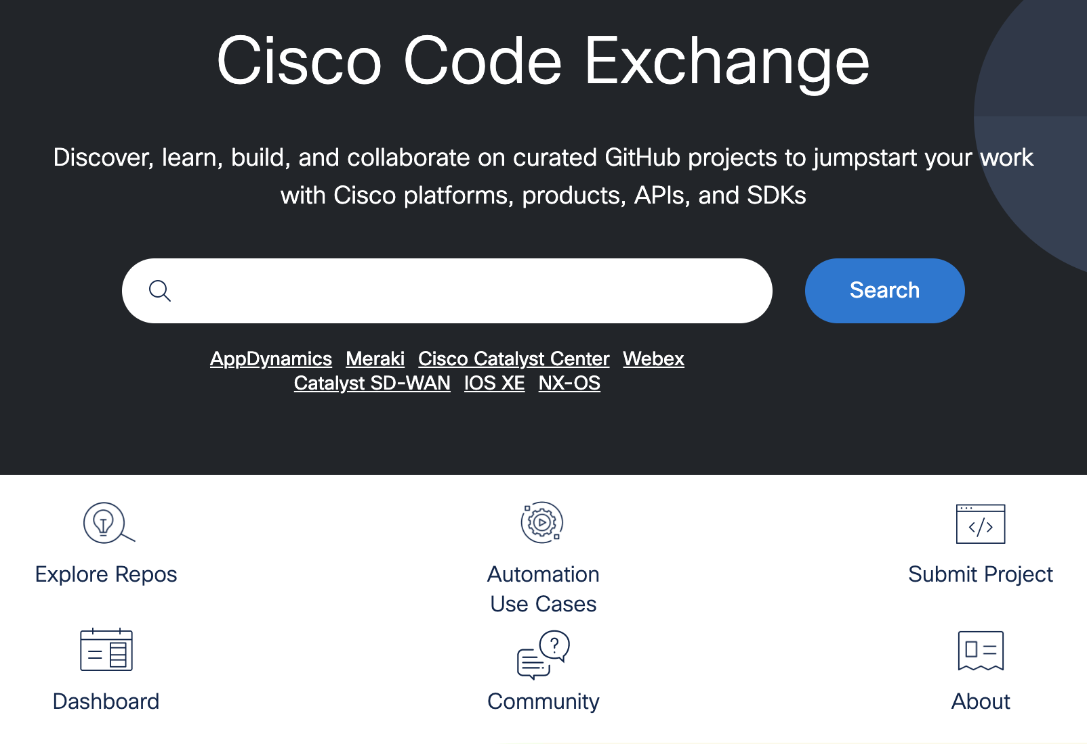
Cisco Code Exchange is the place to discover code repositories related to Cisco technologies: https://developer.cisco.com/codeexchange/
There are currently 24 repos and counting there written entirely in Ansible, for you to use with technologies such as ISE, ACI, NSO, Tetration and more. And there are many more repos at Code Exchange which implement Ansible as part of the repo.
https://developer.cisco.com/codeexchange/search/?languages=Ansible

Slide 54
DevOps Shop: Intro to Ansible for Automation

Slide 55
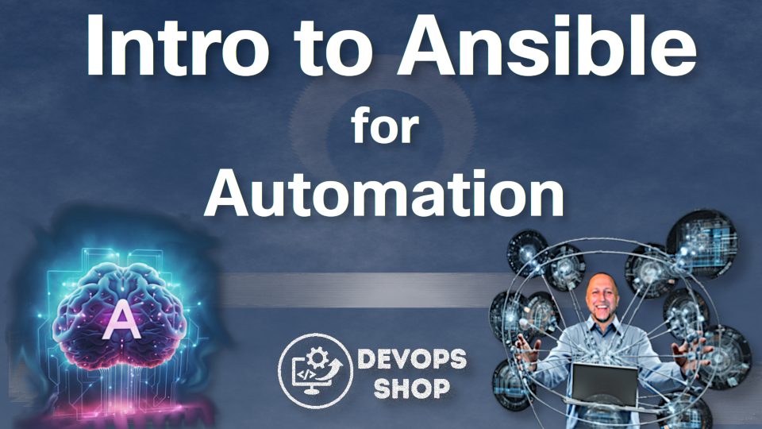
The 7th Edition of the DevOps Shop video series on the Cisco DevNet YouTube Channel is Intro to Ansible for Automation.
Check it out on the Cisco Community:
https://community.cisco.com/t5/devops-blogs/intro-to-ansible-for-automation-devops-shop/ba-p/4896115
Check it out on the DevNet YouTube Channel:
https://www.youtube.com/watch?v=2rDAziMChXs

Slide 56
Summary
Ansible is an open-source, agentless automation tool that can be leveraged for network configuration management functions.
Ansible-playbooks provides capabilities to automate daily operations tasks.
Automating repetitive tasks with Ansible can reduce OPEX costs and improve efficiency.
With increasing support of modules, it is possible to automate even more network functions through Ansible.

Slide 57
What We’ve Learned Today…
…What Ansible is, its main components, and why automation is crucial
…How to use Ansible to automate tedious tasks to achieve idempotency
…Ansible can fetch files from GitHub and run commands to use them as well as perform cURL operations
…How to troubleshoot Ansible operations with the verbose flags
…Where to learn more, including the DevNet Learning Labs and sandboxes, as well as Ansible-Projects and Cisco Code Exchange.
…How to access the Intro to Ansible video of the DevOps Shop series.

Slide 58
Looking forward…
Soon the question may not be be whether a human interacts with a device via CLI , Ansible, or other tool, but how humans can drive AI to program intent via human-readable prompts, and let the ‘machines’ figure out which models, schemas and CLI commands produce the desired intent.
- Mark Culverhouse, Principle Architect
Cisco Systems

Slide 59
Addendum: Ansible-Navigator Future Ansible tool for your edification!

Slide 60
Ansible Navigator
“Considering the shift towards containerized execution of automation, automation development workflow and tooling that existed before Ansible Automation Platform 2 have had to be reimagined. In short, ansible-navigator replaces ansible-playbook and other ansible-* command line utilities.”
- RedHat Ansible

Slide 61
Ansible Navigator
Ansible Navigator is a component of the Ansible Automation Platform (AAP) that provides a graphical interface for working with Ansible. It's designed to make it easier for users to interact with and navigate through Ansible content.

Slide 62
Key features of Ansible Navigator include:
Graphical Interface: Ansible Navigator offers a text-based graphical interface that allows users to visually navigate and interact with Ansible content, making it more accessible for those who prefer graphical tools.
Content Browsing: Users can browse and explore Ansible content, including collections, roles, and modules, in a structured and organized manner.
Documentation Integration: Ansible Navigator integrates Ansible documentation directly into the interface, providing users with context-specific help and information as they work.

Slide 63
Key features of Ansible Navigator (continued):
Workflow Support: It assists users in defining and running Ansible workflows, making it easier to manage complex automation tasks.
Job Execution: Ansible Navigator allows users to execute Ansible jobs directly from the interface, providing a streamlined workflow for managing automation tasks.

Slide 64
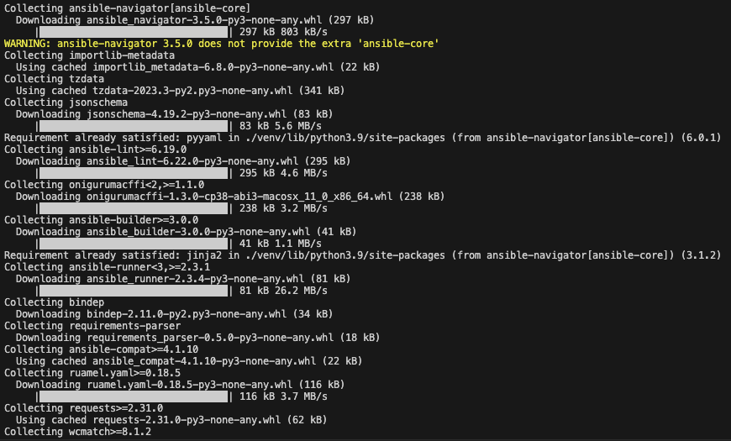
Installing Ansible Navigator
pip3 install 'ansible-navigator[ansible-core]'

Slide 65
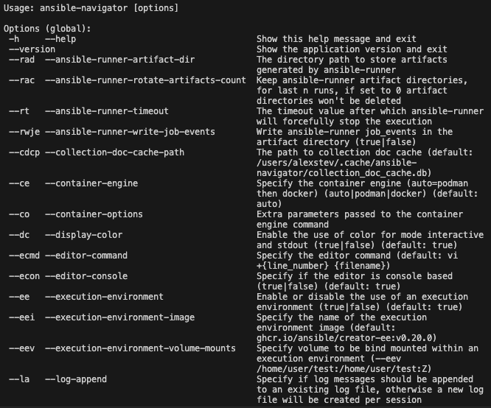
Ansible Navigator – help menu
ansible-navigator --help

Slide 66
Getting Started with Ansible Navigator
By default, ansible-navigator uses a container runtime (podman or docker, whichever it finds first) and runs Ansible within an execution environment (a pre-built container image which includes ansible-core along with a set of Ansible collections.)
This default behavior can be disabled by starting ansible-navigator with --execution-environment false. In this case, Ansible and any collections needed must be installed manually on the system.
Additional Linux, macOS and Windows with WSL2 installation instructions are available at https://ansible.readthedocs.io/projects/navigator/installation/

Slide 67
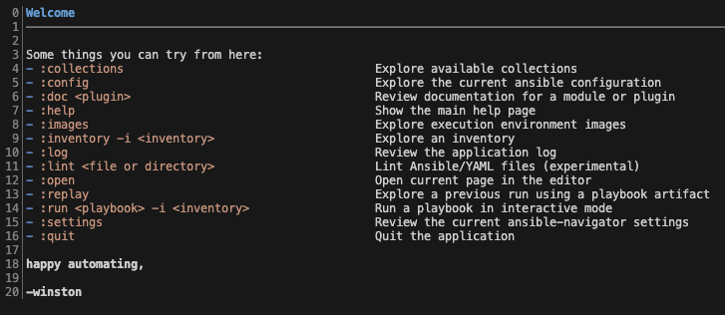
Ansible Navigator ~ Welcome Page
When running ansible-navigator with no arguments, you will be presented with the welcome page. From this page, you can run playbooks, browse collections, explore inventories, read Ansible documentation, and more.

Slide 68
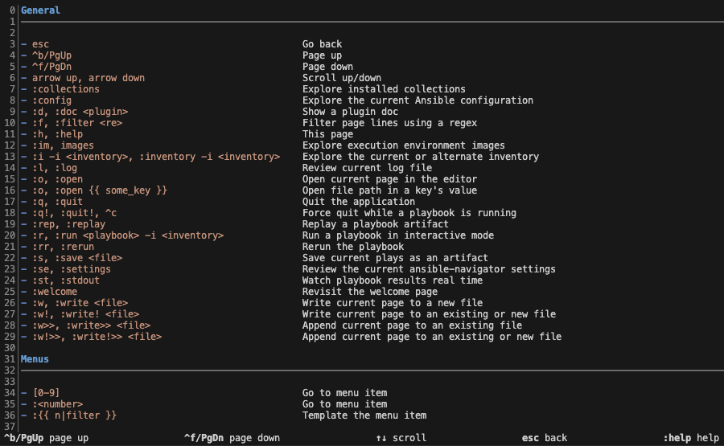
Ansible Navigator ~ Welcome Page :help
A full list of key bindings can be viewed by typing :help.

Slide 69
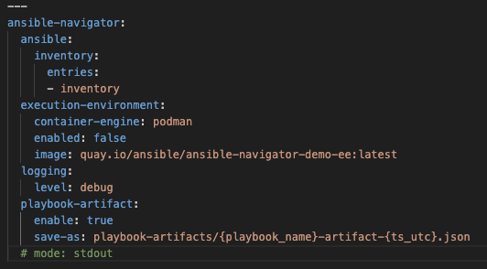
Ansible Navigator ~ Config File
We can write an ~/ansible-navigator.yml config file that will give us a good jumping off point to explore some key features of ansible-navigator

Slide 70
ansible-navigator vs. ansible-playbook
 | ansible-navigator | ansible-playbook
Main Usage | a more comprehensive tool designed to explore, manage, and execute Ansible content, including playbooks, roles, and collections | Used primarily for executing Ansible playbooks
UI | interactive mode: a text user interface (TUI) to navigate through Ansible content and discover available actions | A traditional CLI interface, where you run playbooks by passing flags and specifying playbook files
Execution Environment | supports execution environments, which are containerized environments that isolate Ansible execution | Runs playbooks via local Python environ (e.g., using your system Python or Python virtualenv)
Extensibility | Provides additional features, such as browsing documentation, visualizing inventory, and managing collections, all of which makes it a more versatile tool for working with Ansible | Almost 100% focused on executing playbooks; you sometimes end up having to use other ansible-* tools

Slide 71
Ansible Navigator ~ Summary of Benefits
Ansible Navigator was created to address some limitations of traditional Ansible CLI tools, providing us with a more efficient way to work with Ansible:
Improves the UX by providing a more interactive look and feel
Enhances the discoverability of Ansible content, available actions, and docs
Simplifies the usage of execution environments, allowing us to work with containerized Ansible instances. There is no equivalent functionality available to us with ansible-playbook.

Slide 72

Fill out your Session Surveys!
#CiscoLive
© 2022 Cisco and/or its affiliates. All rights reserved. Cisco Public

Slide 73
Continue your education
Visit the Cisco Showcase for related demos
Book your one-on-one Meet the Engineer meeting
Attend the interactive education with DevNet, Capture the Flag, and Walk-in Labs
Visit the On-Demand Library for more sessions at www.CiscoLive.com/on-demand
Contact me at: Insert preferred comms method

